Slide 1


Deep Learning
Class 7

Slide 2
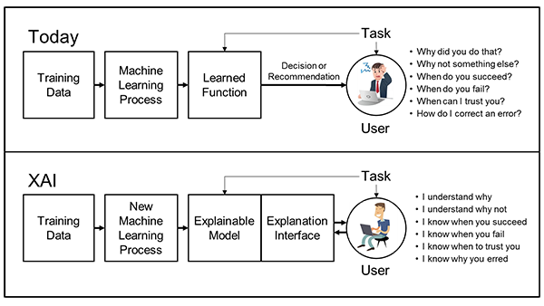
Explainable AI

Slide 3
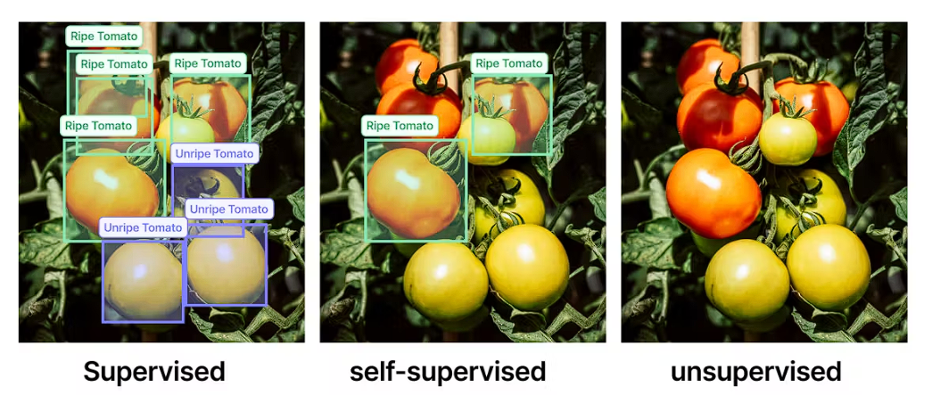
Self-Supervised Learning

Slide 4
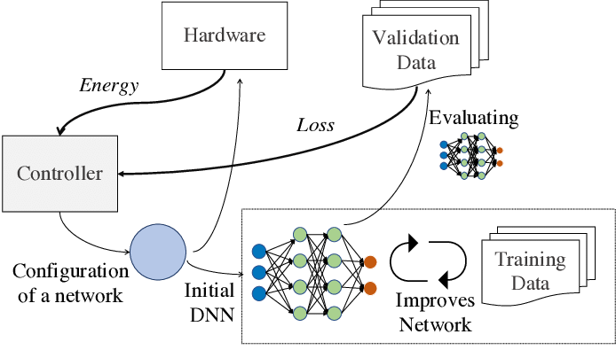
Neural Architecture Search (NAS)

Slide 5
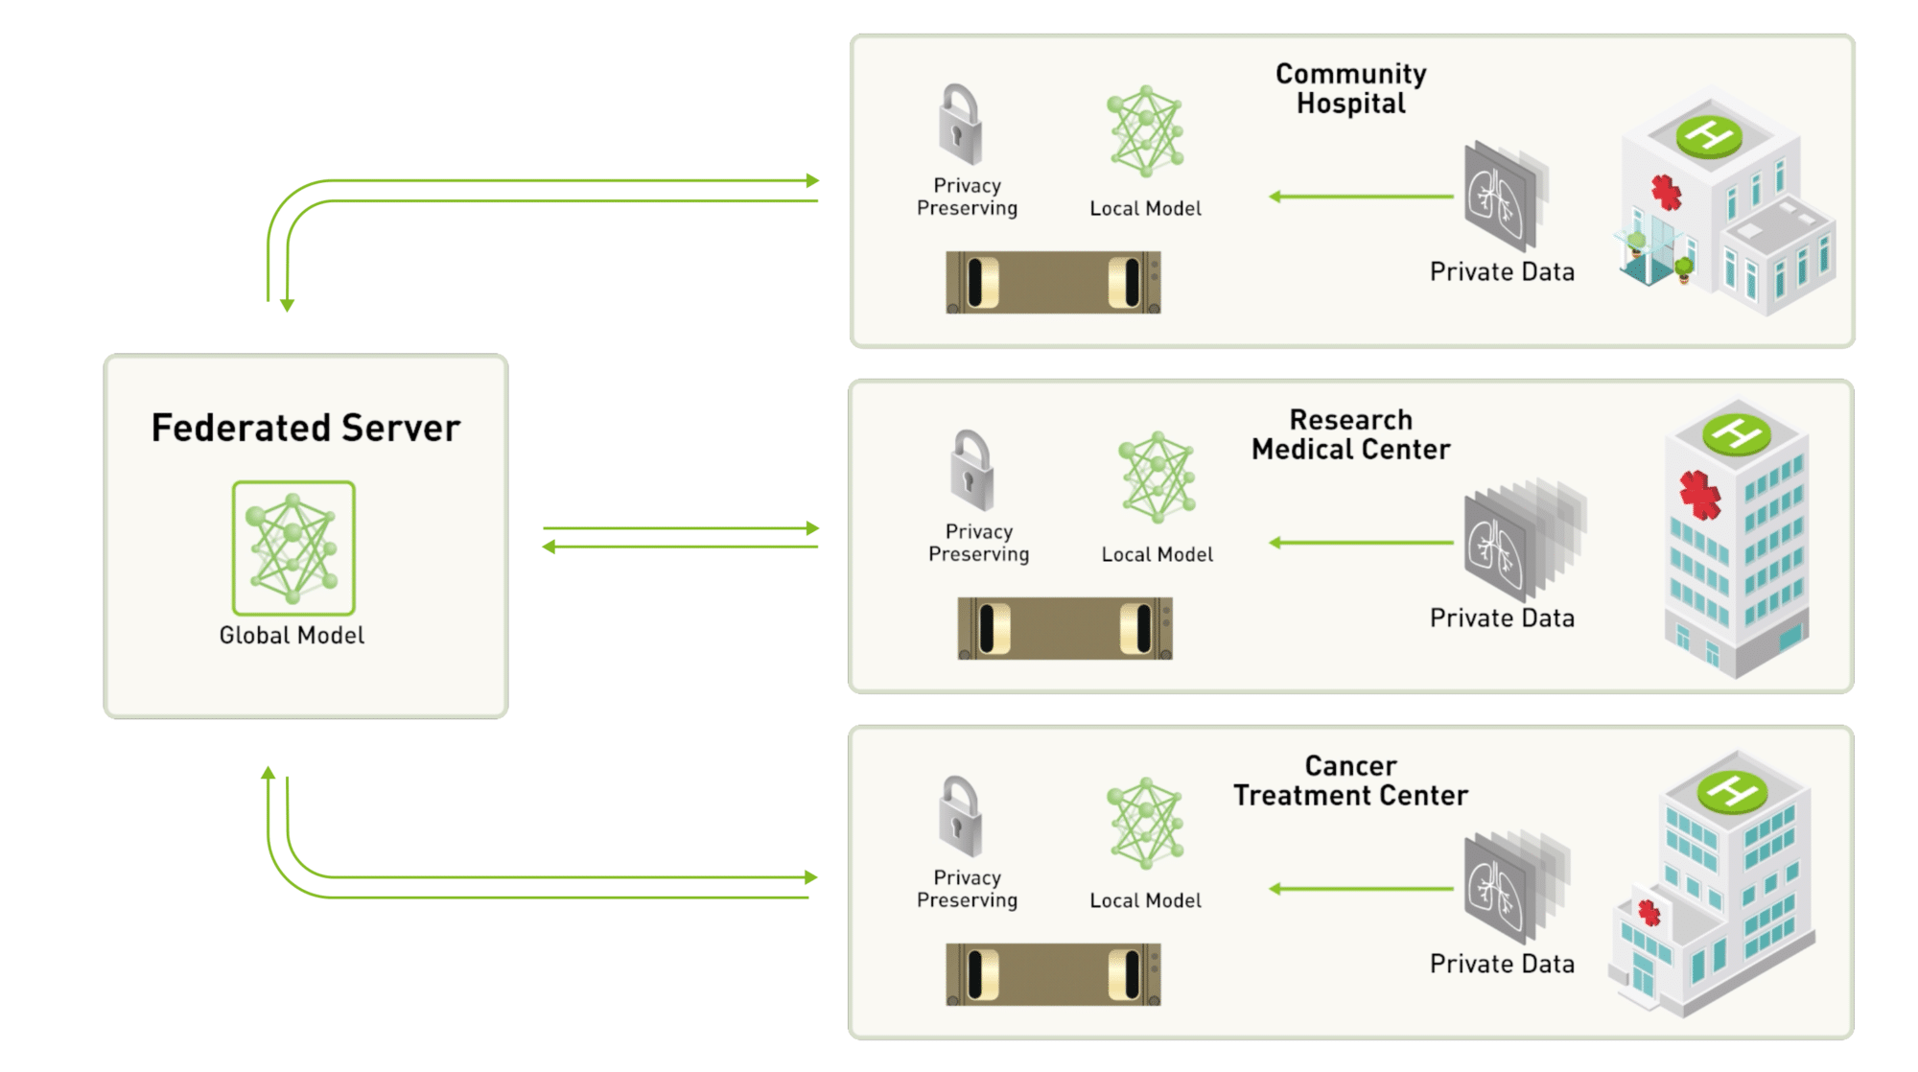
Federated Learning

Slide 6
Meta Learning
meta-level: model learns across a distribution of tasks or environments
Task level: model learns within a specific task or environment

Slide 7
How to read research papers

